Slide 1
CSE302-Software Quality Engineering Software Quality Metrics
Instructor: Sobia Usman
Assistant Professor
CS - CUI, LHR

Slide 2
What are Metrics?
“A quantitative measure of the degree
to which a system, component,
or process possesses a given attribute”.
IEEE Standard Glossary [IEE93]

Slide 3
"When you can measure what you are speaking about and express it in numbers, you know something about it; but when you cannot measure it, when you cannot express it in numbers, your knowledge is of a meagre and unsatisfactory kind: it may be the beginnings of knowledge but you have scarcely in your thoughts advanced to the stage of Science."
Lord Kelvin (Physicist)
"You cannot control what you cannot measure."
Tom DeMarco (Software Engineer)

Slide 4
Software Metric
A metric quantifies a characteristic of a process or product.
Metrics can be directly observable quantities or can be derived from one or more directly observable quantities.

Slide 5
Software Metric
Raw Metrics
number of source lines of code,
Derived Metrics
source lines of code per staff-hour,
number of documentation pages,
number of staff-hours,
number of requirements, etc.
number of tests,
defects per thousand lines of code,
cost performance index.

Slide 6
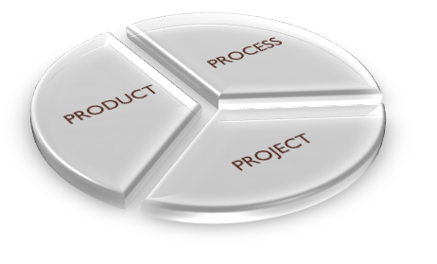
Categories of Software Metrics
Product metrics
Process metrics
Project metrics

Slide 7
Categories of Software Metrics
Product metrics are those that describe the characteristics of the product
Process metrics are those that can be used for improving the software development and maintenance process
Project metrics are those that describe the project characteristics and execution

Slide 8
Product
Metrics
size,
Process
Metrics
effectiveness of defect removal during development,
Project
Metrics
number of software developers,
complexity,
design features,
performance,
quality level
pattern of testing defect arrival,
response time of the fix process
staffing pattern over the life cycle of the software,
cost,
schedule,
productivity

Slide 9
Software Quality Metrics
Software quality metrics are a subset of software metrics that focus on quality aspects of the product, process, and project
In general, software metrics are more closely associated with process and product metrics than with project metrics
Nonetheless, the project parameters such as number of developers and their skill levels, the schedule, the size, and the organization structure certainly affect the quality of the product

Slide 10
Common Measurements - 1
Requirements
Size of the document (# of words, pages, functions)
Number of changes to the original requirements, which were developed later in the life cycle but not specified in the original requirements document.
Consistency measures to ensure that the requirements are consistent with interfaces from other systems
Testability measures to evaluate if the requirements are written in such a way that the test cases can be developed and traced to the requirements

Slide 11
Common Measurements - 2
The system must be user friendly. (What does user friendly mean?)
The system must give speedy response time (What is speedy response time? 10 seconds, 13 seconds?)
The system must have state-of-the-art technology (What is considered state-of-the-art?)
The system must have clear management reports (What should these reports look like? What is the definition of clear?)

Slide 12
Common Measurements - 3
Code/Design
No of external data items from which a module reads
No of external data items to which a module writes
No of modules specified at a later phase and not in the original design
No of modules which the given module calls

Slide 13
Common Measurements - 4
Design/Code
No of lines of code
Data usage, measured in terms of the number of primitive data items
Entries/exits per module which predict the completion time of the system

Slide 14
Common Measurements - 5
Testing
No of planned test cases in the test plan that ran successfully
Success/effectiveness of test cases against the original test plan
No of new unplanned test cases which are developed at a later time

Slide 15
Seven Commonly Tracked Measures
Number of defects
Work effort
Schedule
Number of changes to the requirements
Size
Documentation defects
Complexity

Slide 16
Number of Defects
Defect count can be kept at three different stages
During white box testing to evaluate the quality of original code
During black box testing to evaluate the number of errors that escaped white box
After the product is released to the customer to evaluate the number of errors not found during both the unit and black box tests

Slide 17
Work Effort
Work effort constitutes the number of hours spent on development of a new system, system enhancement, or the support and maintenance of an existing system
The hours are collected throughout the project life cycle, across all the development phases
Can provide early warnings regarding budget over-runs and project delays

Slide 18
Schedule
The purpose of schedule measurements is to track the performance of the project team toward meeting the committed schedule
Planned start date versus actual date
Planned completion date versus actual date

Slide 19
Number of Changes to the Requirements
The number of additions, changes, and deletions to requirements should be measured as soon as the requirements document is checked into the formal configuration management
This measure reflects the quality of requirements and the need to change the process of either collecting the requirements or documenting them
Once the software is released, enhancement requests resulting from customer calls or updates due to problem fixes are also counted as changes are made

Slide 20
Size - 1
The size measures are important because the amount of effort required to perform most tasks is directly related to the size of the program involved
The size is usually measured in
Lines of code
Function Points

Slide 21
Size - 2
When the size grows larger than expected, the cost of the project as well as the estimated time for completion also grow
The size of the software is also used for estimating the number of resources required
The measure used to estimate program size should be easy to use early in the project life cycle

Slide 22
Size – 3 – Lines of Code
Empty lines
Comments/statements
Source lines
Reused lines
Lines used from other programs

Slide 23
Size – 4 – Function Points - 1
It is a method of quantifying the size and complexity of a software system based on a weighted user view of the
number of external inputs to the application;
number of outputs from the application;
inquiries end users can make;
interface files;
and internal logical files updated by an application
These five items are counted and multiplied by weight factors that adjust them for complexity

Slide 24
Size – 5 – Function Points - 2
Function points are independent of languages, can be used to measure productivity and number of defects, are available early during functional design, and the entire product can be counted in a short time
They can be used for a number of productivity and quality metrics, including defects, schedules, and resource utilization

Slide 25
Documentation Defects
The documentation defects are counted throughout project life cycle
Defects of the following nature are tracked
Missing functionality
Unclear explanation
Spellings
Not user friendly

Slide 26
Complexity - 1
This metric gives data on the complexity of the software code
As the complexity of the software increases, the required development effort increases and the probability of defects increases
Complexity can be measured at as many successive levels as possible beginning at the individual software module level

Slide 27
Complexity - 2
The complexity of a module can be evaluated by
Number of files
Program size
Number of verbs, if statements, paragraphs, total lines, and loops
Design complexity which is measured by
Modularity (how well as design is decomposed into small, manageable modules)
Coupling (the interfaces between units)

Slide 28
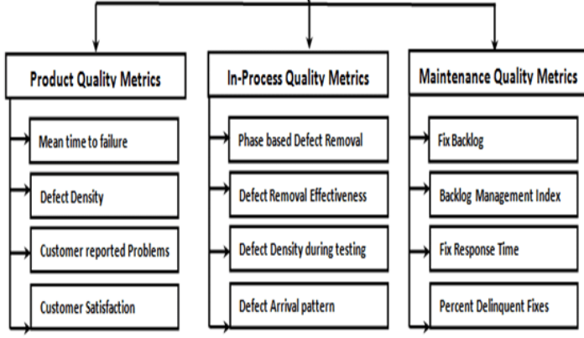

Slide 29
Process Metrics
Defect removal effectiveness
Defect arrival rate
Test effectiveness
Defects by phase

Slide 30
Defect Removal Effectiveness (DRE)
This metrics may be applied on phase-by-phase basis to measure the relative effectiveness of defect removal.
Will indicate the effectiveness of the defect identification and removal.
Weak areas in the process may be identified for improvement
DRE is the percentage of bugs eliminated by reviews, inspections, tests etc.
Formula
DRE = Defects removed (at the step)/ defects existing on step entry+ total Defects injected (of this step)

Slide 31
Exercise
 | Requirement | Design | Code | Total (Removed defects)
Requirement Review | 15 | - | - | 15
Design Review | 5 | 29 | - | 34
Code Review | 1 | 3 | 54 | 58
Unit Testing | 0 | 4 | 32 | 36
Integration testing | 1 | 3 | 13 | 17
System Testing | 2 | 0 | 6 | 8
Operations | 1 | 2 | 7 | 10
Total(Injected) | 25 | 41 | 112

Slide 32
Exercise:
From the above table it is clear that for the requirements phase, 15 requirement type defects were found and fixed during that phase. 10 requirement type defects were found in later phases for a total of 25 requirement type defects.
For design phase, 29 design type defects were found and fixed
during that phase and 12 design type defects were found in later phases for a total of 41 design type defects and so on.

Slide 33
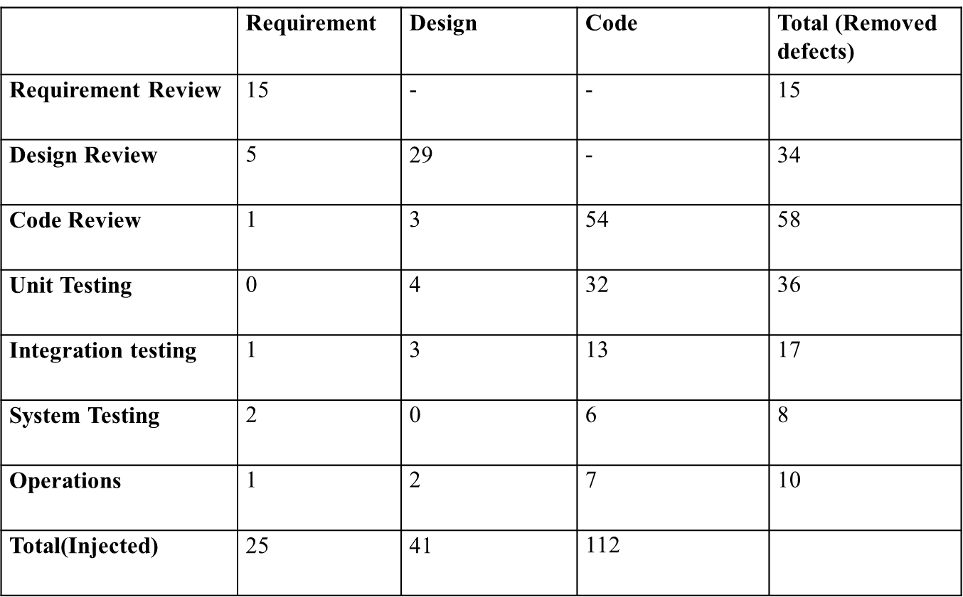
Requirements Review Effectiveness
Defects removed at requirement review phase: 15
Defects existing on step entry: 0
Defects injected : 10
(15/0+25)*100= 60%

Slide 34
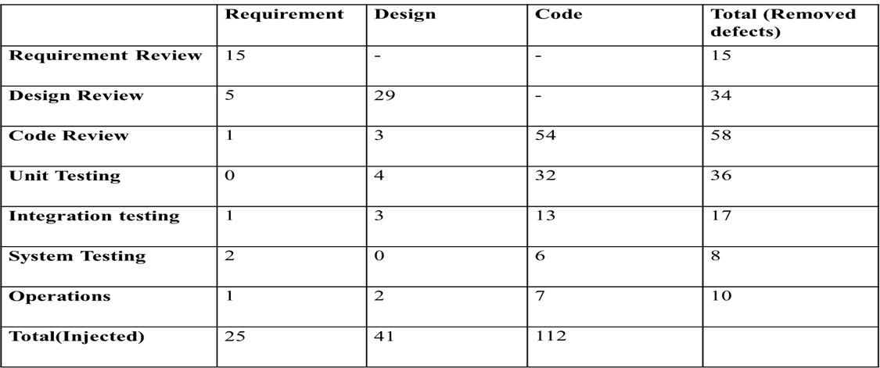
Design Review Effectiveness
Defects Removed at Design Review phase: 34
Defects existing on step entry (escapes from Requirements phase):
25 – 15(these 15 already removed in requirements phase) = 10
Defects injected in the current phase:41
(34/(41+10)) x 100 = 67%

Slide 35
Code Review Effectiveness
Defects Removed at Code Review phase: 58 Defects existing on step entry (escapes from Requirements & Design phase): 25 +41-34-15=17 Defects injected in the current phase: 112 (58/17+112) x 100 = 45%

Slide 36
Testing Effectiveness
For testing phases, the defect injection is usually a smaller number, in such cases efficiency is calculated by a different method:
Effectiveness = Defects removed at current phase / Defects removed at current phase + Defects removed at subsequent phases
Unit Testing Effectiveness: 36/(36+17+8+10) X 100 = 51%
Integration Testing Effectiveness: 17/(17+8+10) X 100 = 49%

Slide 37
Defect Arrival Rate (DAR)
It is the number of defects found during testing measured at regular intervals over some period of time
Rather than a single value a set of values is associated with this metrics
When plotted on a graph
the data may rise, indicating a positive defect arrival rate
It may stay flat, indicating a constant defect arrival rate
Or decrease, indicating a negative defect arrival rate

Slide 38
Defect Arrival Rate – 2
Interpretation of the results of this metric can be very difficult
Intuitively, one might interpret a negative defect arrival rate to indicate that the product is improving since the number of new defects found is declining over time
To validate this interpretation, you must eliminate certain possible causes for the decline

Slide 39
Defect Arrival Rate – 3
For example, it could be that test effectiveness is declining over time. In other words, the tests may only be effective at uncovering certain types of problems. Once those problems have been found, the tests are no longer effective

Slide 40
Defect Arrival Rate – 4
Another possibility is that the test organization is understaffed and consequently is unable to adequately test the product between measurement intervals.
They focus their efforts during the first interval on performing stress tests that expose many problems, followed by executing system tests during the next interval where fewer problems are uncovered

Slide 41
Test Effectiveness
Test effectiveness (TE) is measured as
TE = D_{n} / T_{n}
D_{n} is the number of defects found by formal tests
T_{n} is the total number of formal tests
When calculated at regular intervals and plotted:
If the graph rises over time, TE may be improving
If the graph is falling over time, TE may be waning
The interpretation should made in the context of other metrics being used in the process

Slide 42
Defects by Phase - 1
It is much less expensive in terms of resources and reputation to eliminate defects early instead of fix late
At the conclusion of each discreet phase of the development process, a count of the new defects is taken and plotted to observe a trend

Slide 43
Defects by Phase - 2
If the graph appears to be rising, you might infer that the methods used for defect detection and removal during the earlier phases are not effective since the rate at which new defects are being discovered is increasing
On the other hand, if the graph appears to be falling, you might conclude that early defect detection and removal is effective

